Slide 1
BIEN 401 Biomedical Mass Transport Class 5 Diffusion and Fick’s Laws
notes prepared by
Dr. Louis Reis
Created on 3/14/2022

Slide 2
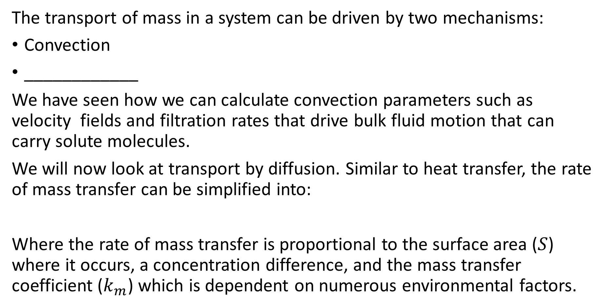
Mass Transport
The transport of mass in a system can be driven by two mechanisms:
Convection
____________
We have seen how we can calculate convection parameters such as velocity fields and filtration rates that drive bulk fluid motion that can carry solute molecules.
We will now look at transport by diffusion. Similar to heat transfer, the rate of mass transfer can be simplified into:
Where the rate of mass transfer is proportional to the surface area ($S$) where it occurs, a concentration difference, and the mass transfer coefficient ($k_{m}$) which is dependent on numerous environmental factors.

Slide 3
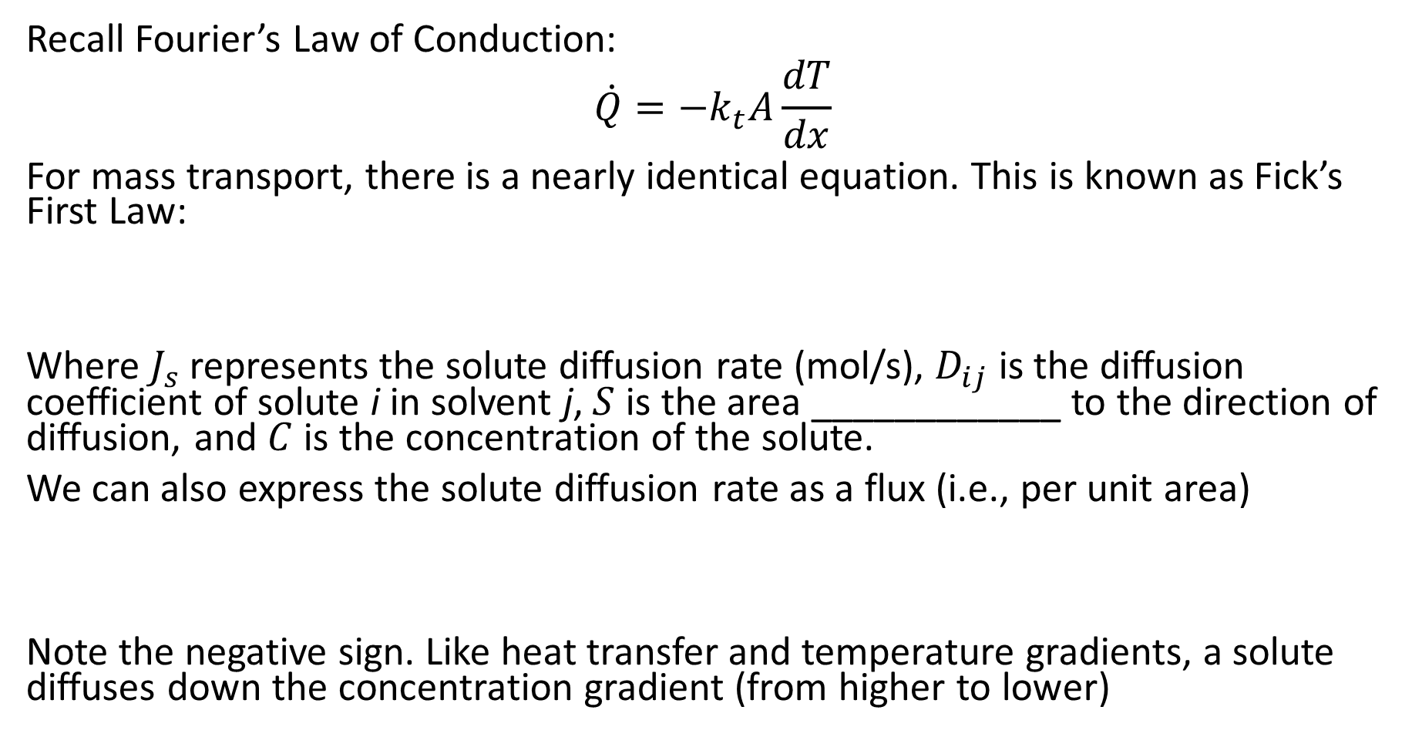
Fick’s First Law
Recall Fourier’s Law of Conduction:
$$\dot{Q}=−k_{t}A\frac{dT}{dx}$$
For mass transport, there is a nearly identical equation. This is known as Fick’s First Law:
Where $J_{s}$ represents the solute diffusion rate (mol/s), $D_{ij}$ is the diffusion coefficient of solute i in solvent j, $S$ is the area ____________ to the direction of diffusion, and $C$ is the concentration of the solute.
We can also express the solute diffusion rate as a flux (i.e., per unit area)
Note the negative sign. Like heat transfer and temperature gradients, a solute diffuses down the concentration gradient (from higher to lower)

Slide 4
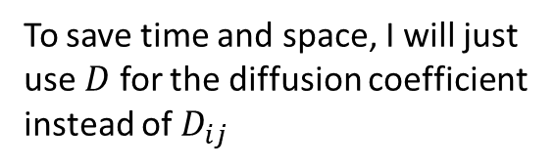
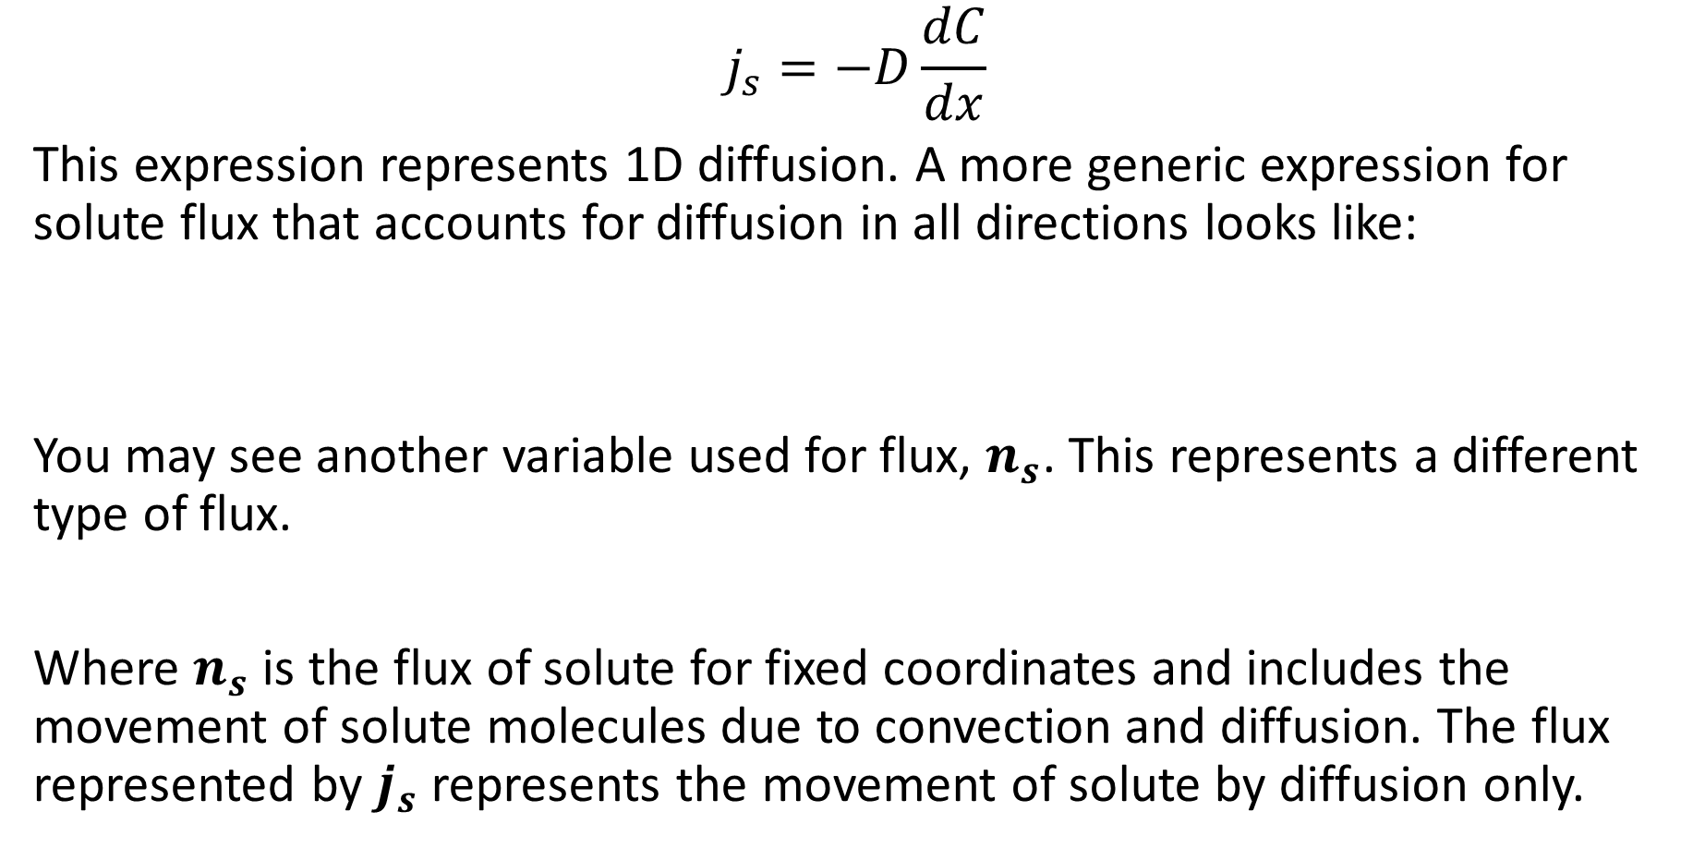
Fick’s First Law
To save time and space, I will just use $D$ for the diffusion coefficient instead of $D_{ij}$
$$j_{s}=−D\frac{dC}{dx}$$
This expression represents 1D diffusion. A more generic expression for solute flux that accounts for diffusion in all directions looks like:
You may see another variable used for flux, $n_{s}$. This represents a different type of flux.
Where $n_{s}$ is the flux of solute for fixed coordinates and includes the movement of solute molecules due to convection and diffusion. The flux represented by $j_{s}$ represents the movement of solute by diffusion only.

Slide 5
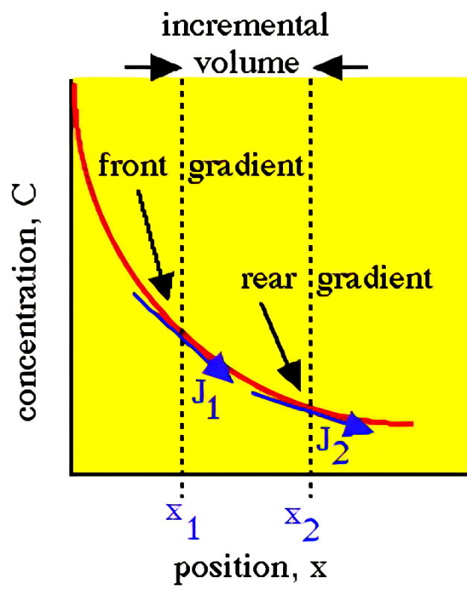
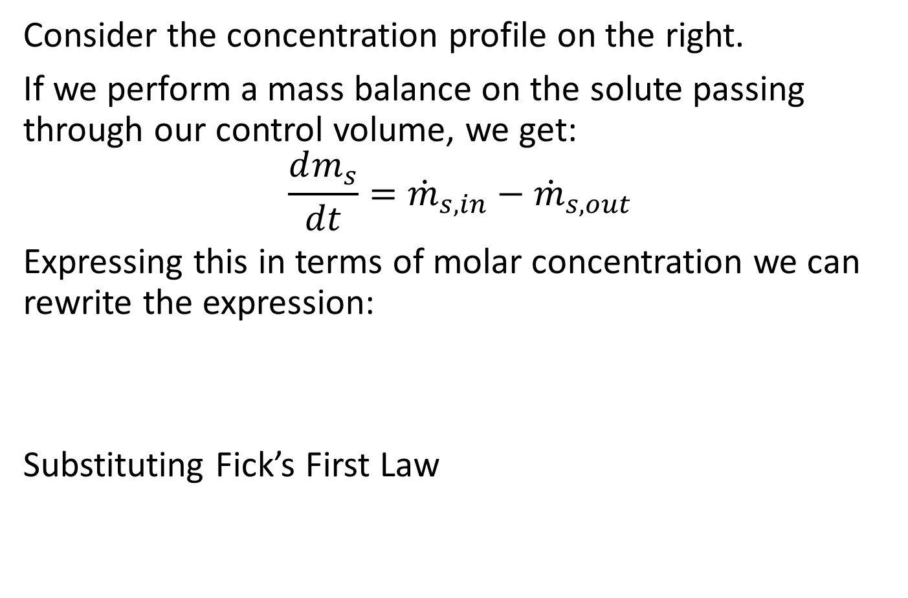
Fick’s Second Law
Consider the concentration profile on the right.
If we perform a mass balance on the solute passing through our control volume, we get:
$$\frac{dm_{s}}{dt}={\dot{m}}_{s,in}−{\dot{m}}_{s,out}$$
Expressing this in terms of molar concentration we can rewrite the expression:
Substituting Fick’s First Law

Slide 6
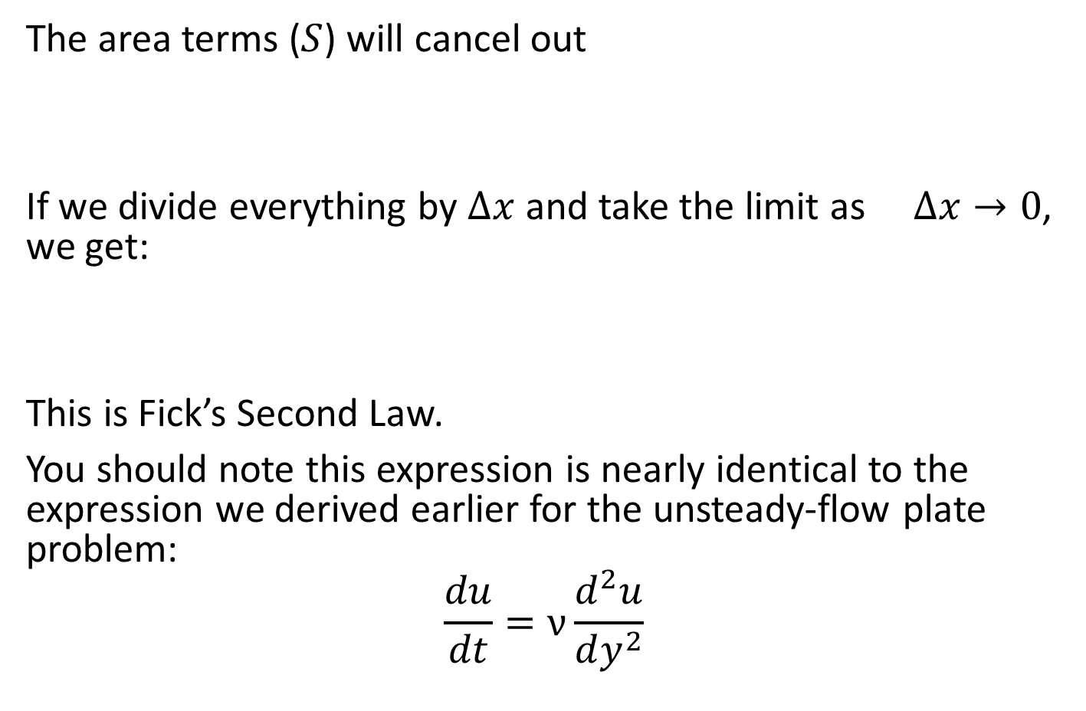
Fick’s Second Law
The area terms ($S$) will cancel out
If we divide everything by $∆x$ and take the limit as $∆x→0$, we get:
This is Fick’s Second Law.
You should note this expression is nearly identical to the expression we derived earlier for the unsteady-flow plate problem:
$$\frac{du}{dt}=ν\frac{d^{2}u}{dy^{2}}$$

Slide 7










Fick’s Laws Example
Consider a problem similar to the one we did last class.
A block with a concentrated solute $C_{0}$ is placed in a still solvent fluid initially free of any solute. The solute will naturally diffuse from the surface of the block into the solvent above it. Develop an expression for determining the distance the solute has traveled in the solution (as a function of time) such that the concentration of the solute is 1% of the original concentration.
$$y$$
$$y$$
$$y$$
$$t=0$$
$$t>0$$
$$t≫0$$
$$C_{0}$$
$$C_{0}$$
$$C_{0}$$

Slide 8
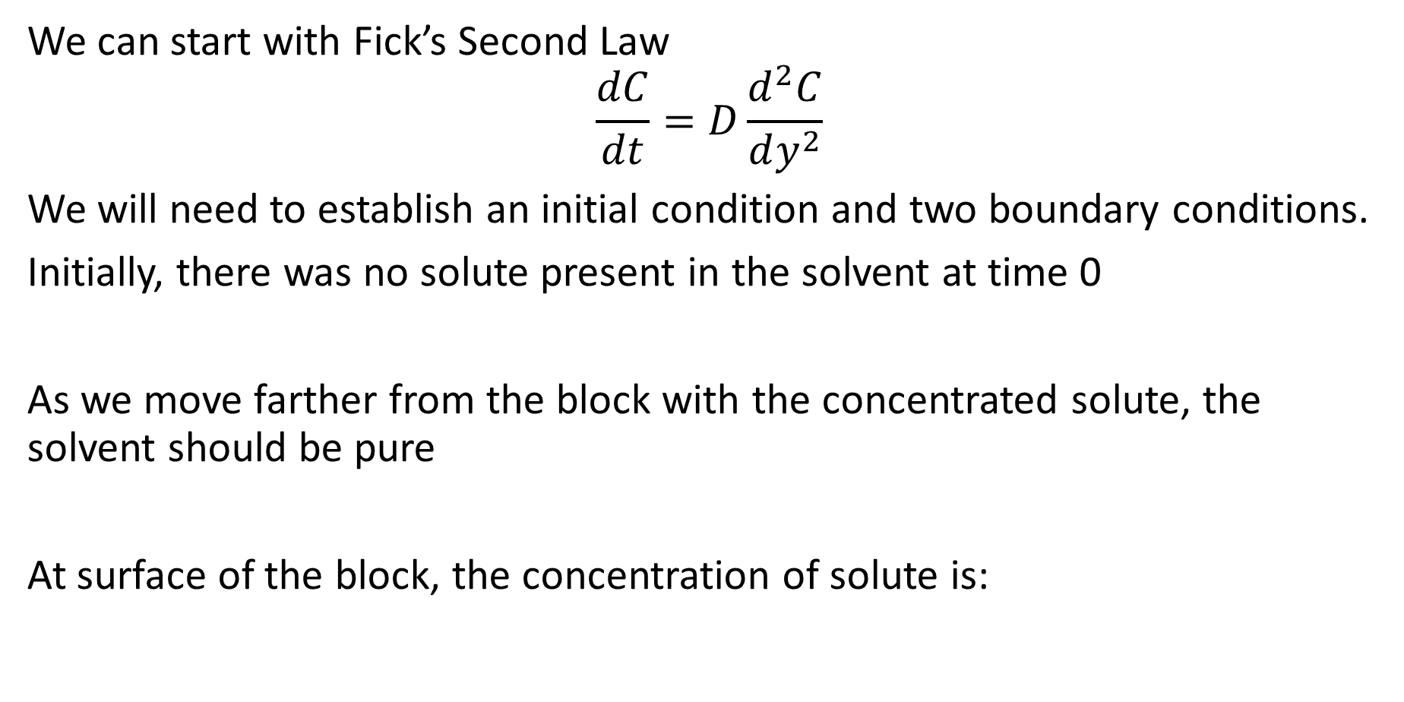
Fick’s Laws Example
We can start with Fick’s Second Law
$$\frac{dC}{dt}=D\frac{d^{2}C}{dy^{2}}$$
We will need to establish an initial condition and two boundary conditions.
Initially, there was no solute present in the solvent at time 0
As we move farther from the block with the concentrated solute, the solvent should be pure
At surface of the block, the concentration of solute is:

Slide 9
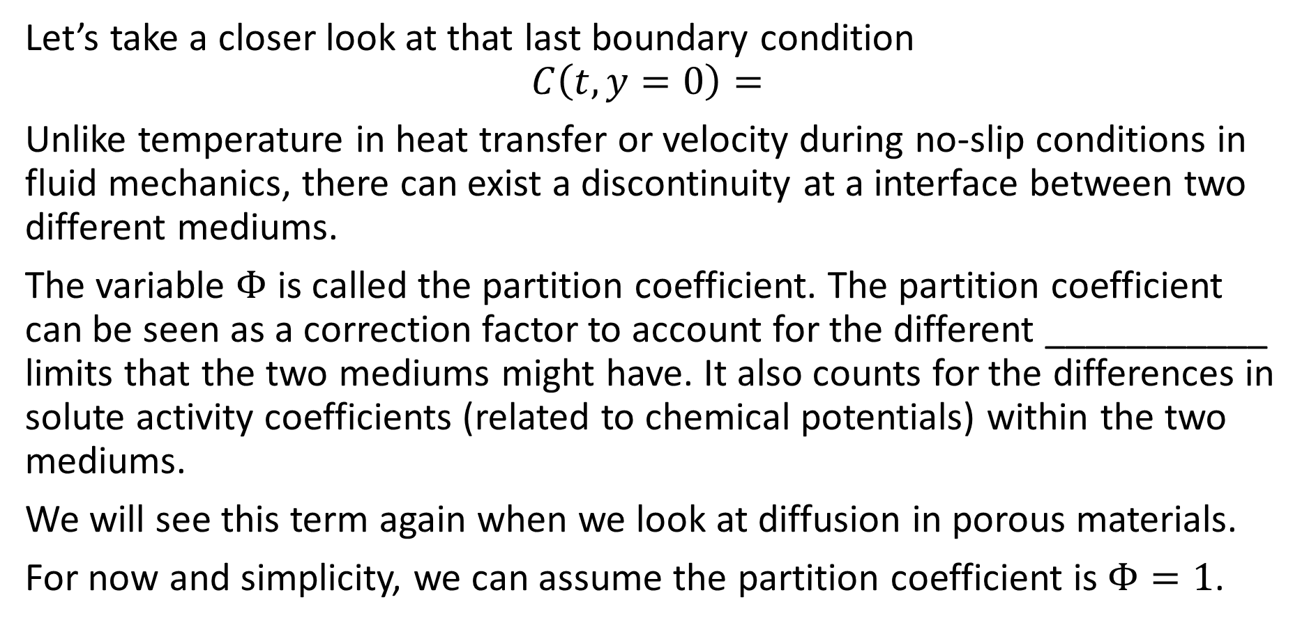
Partition Coefficient
Let’s take a closer look at that last boundary condition
$$C\left(t,y=0\right)=$$
Unlike temperature in heat transfer or velocity during no-slip conditions in fluid mechanics, there can exist a discontinuity at a interface between two different mediums.
The variable $Φ$ is called the partition coefficient. The partition coefficient can be seen as a correction factor to account for the different ___________ limits that the two mediums might have. It also counts for the differences in solute activity coefficients (related to chemical potentials) within the two mediums.
We will see this term again when we look at diffusion in porous materials.
For now and simplicity, we can assume the partition coefficient is $Φ=1$.

Slide 10
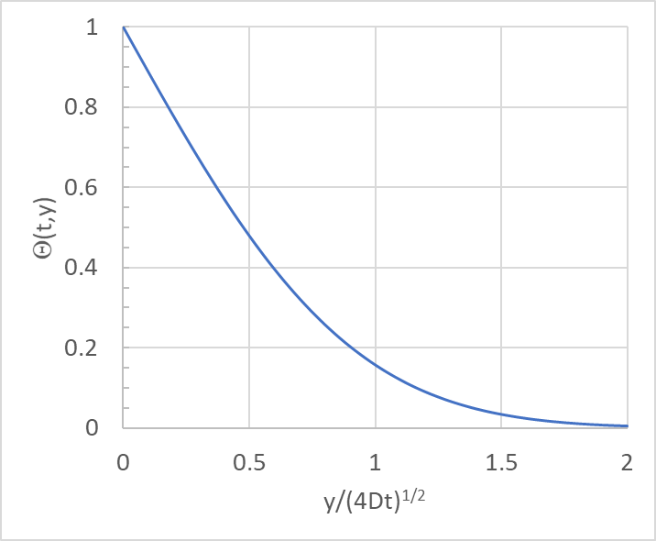
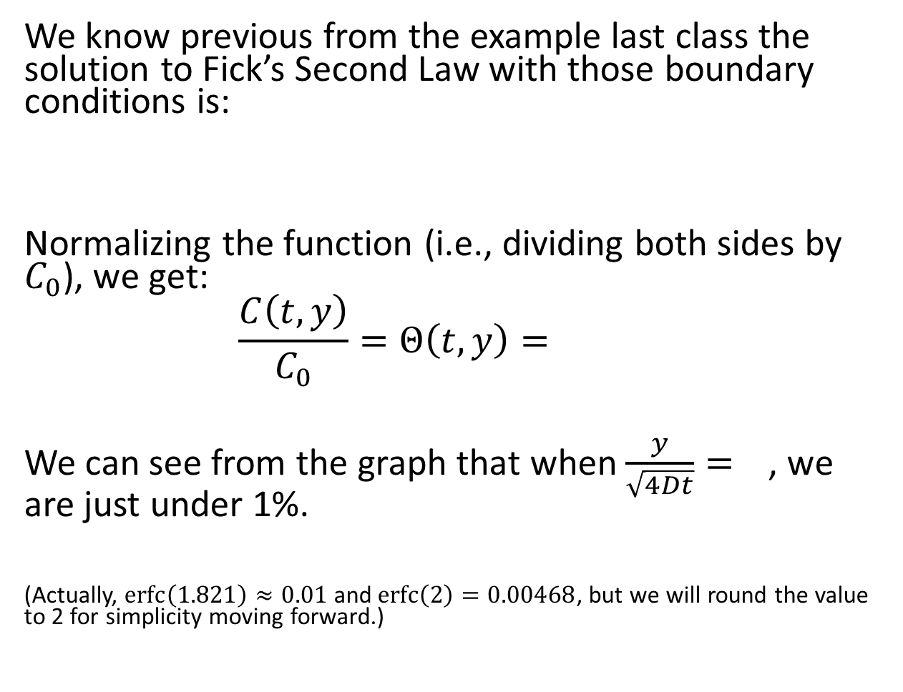
Fick’s Laws Example
We know previous from the example last class the solution to Fick’s Second Law with those boundary conditions is:
Normalizing the function (i.e., dividing both sides by $C_{0}$), we get:
$$\frac{C\left(t,y\right)}{C_{0}}=Θ\left(t,y\right)=$$
We can see from the graph that when $\frac{y}{\sqrt{4Dt}}=$, we are just under 1%.
(Actually, $\operatorname{erfc}\left(1.821\right)≈0.01$ and $\operatorname{erfc}\left(2\right)=0.00468$, but we will round the value to 2 for simplicity moving forward.)

Slide 11
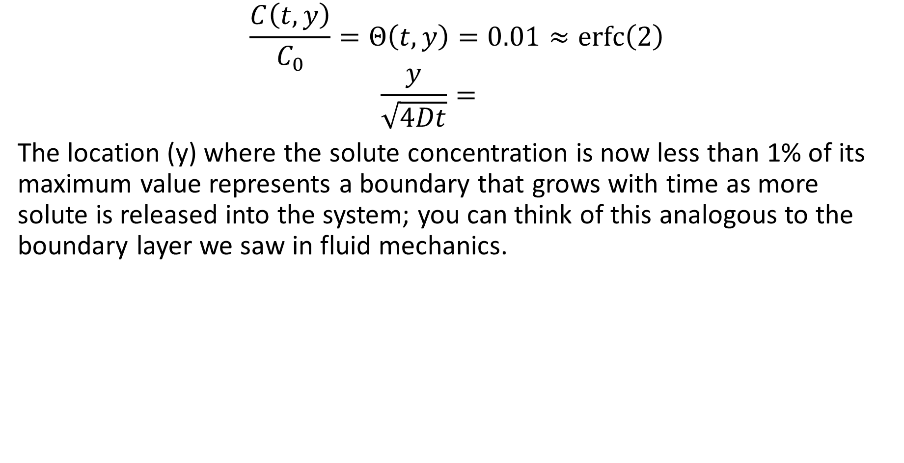
Fick’s Laws Example
$$\frac{C\left(t,y\right)}{C_{0}}=Θ\left(t,y\right)=0.01≈\operatorname{erfc}\left(2\right)$$
$$\frac{y}{\sqrt{4Dt}}=$$
The location (y) where the solute concentration is now less than 1% of its maximum value represents a boundary that grows with time as more solute is released into the system; you can think of this analogous to the boundary layer we saw in fluid mechanics.

Slide 12
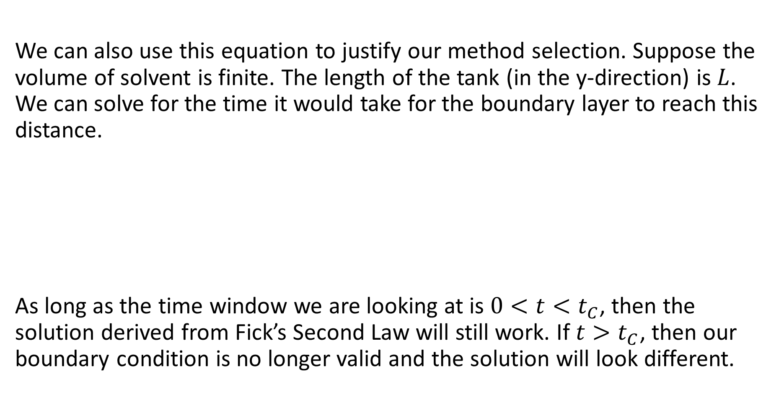
Fick’s Laws Example
We can also use this equation to justify our method selection. Suppose the volume of solvent is finite. The length of the tank (in the y-direction) is $L$. We can solve for the time it would take for the boundary layer to reach this distance.
As long as the time window we are looking at is $0<t<t_{C}$, then the solution derived from Fick’s Second Law will still work. If $t>t_{C}$, then our boundary condition is no longer valid and the solution will look different.

Slide 13
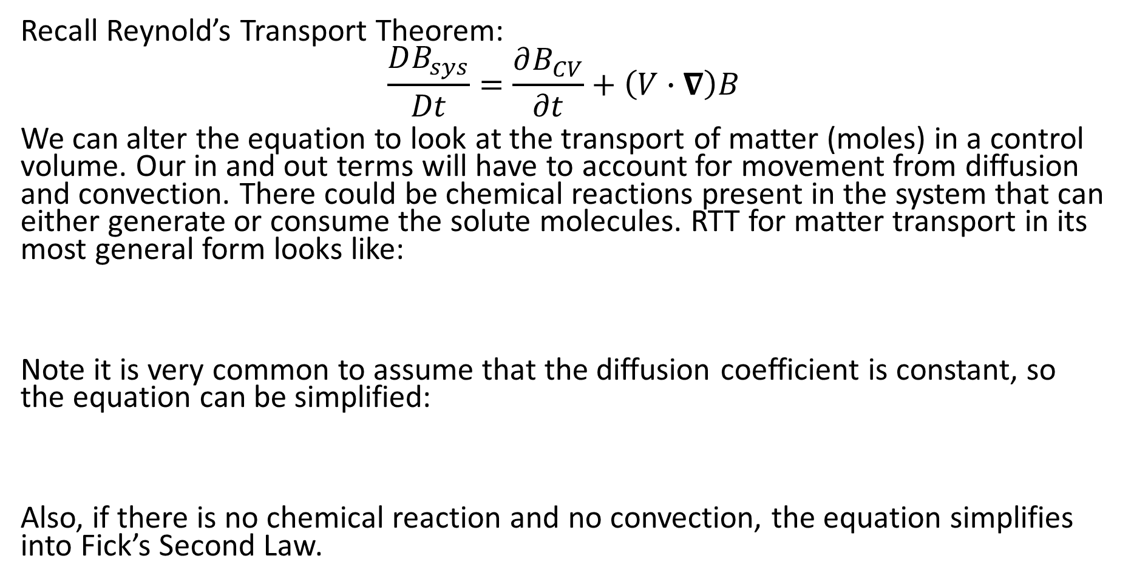
Overall Mass Balance
Recall Reynold’s Transport Theorem:
$$\frac{DB_{sys}}{Dt}=\frac{∂B_{CV}}{∂t}+\left(V∙∇\right)B$$
We can alter the equation to look at the transport of matter (moles) in a control volume. Our in and out terms will have to account for movement from diffusion and convection. There could be chemical reactions present in the system that can either generate or consume the solute molecules. RTT for matter transport in its most general form looks like:
Note it is very common to assume that the diffusion coefficient is constant, so the equation can be simplified:
Also, if there is no chemical reaction and no convection, the equation simplifies into Fick’s Second Law.

Slide 14
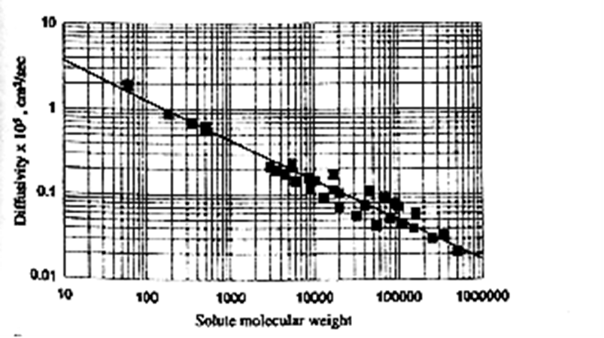
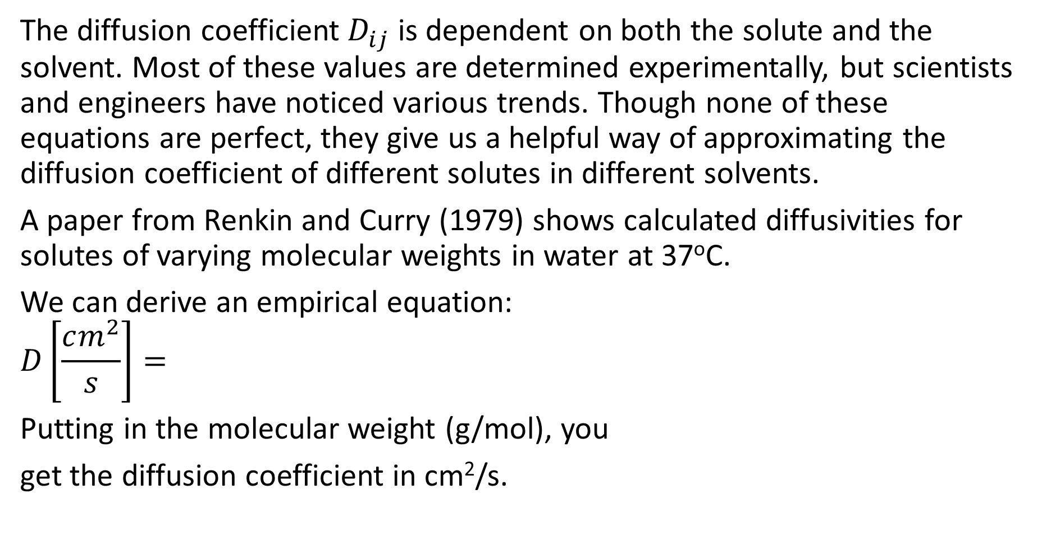

Diffusion Coefficient
The diffusion coefficient $D_{ij}$ is dependent on both the solute and the solvent. Most of these values are determined experimentally, but scientists and engineers have noticed various trends. Though none of these equations are perfect, they give us a helpful way of approximating the diffusion coefficient of different solutes in different solvents.
A paper from Renkin and Curry (1979) shows calculated diffusivities for solutes of varying molecular weights in water at 37ºC.
We can derive an empirical equation:
$$D\left[\frac{cm^{2}}{s}\right]=$$
Putting in the molecular weight (g/mol), you
get the diffusion coefficient in cm²/s.
$$×{10}^{−5}, cm^{2}/sec$$

Slide 15
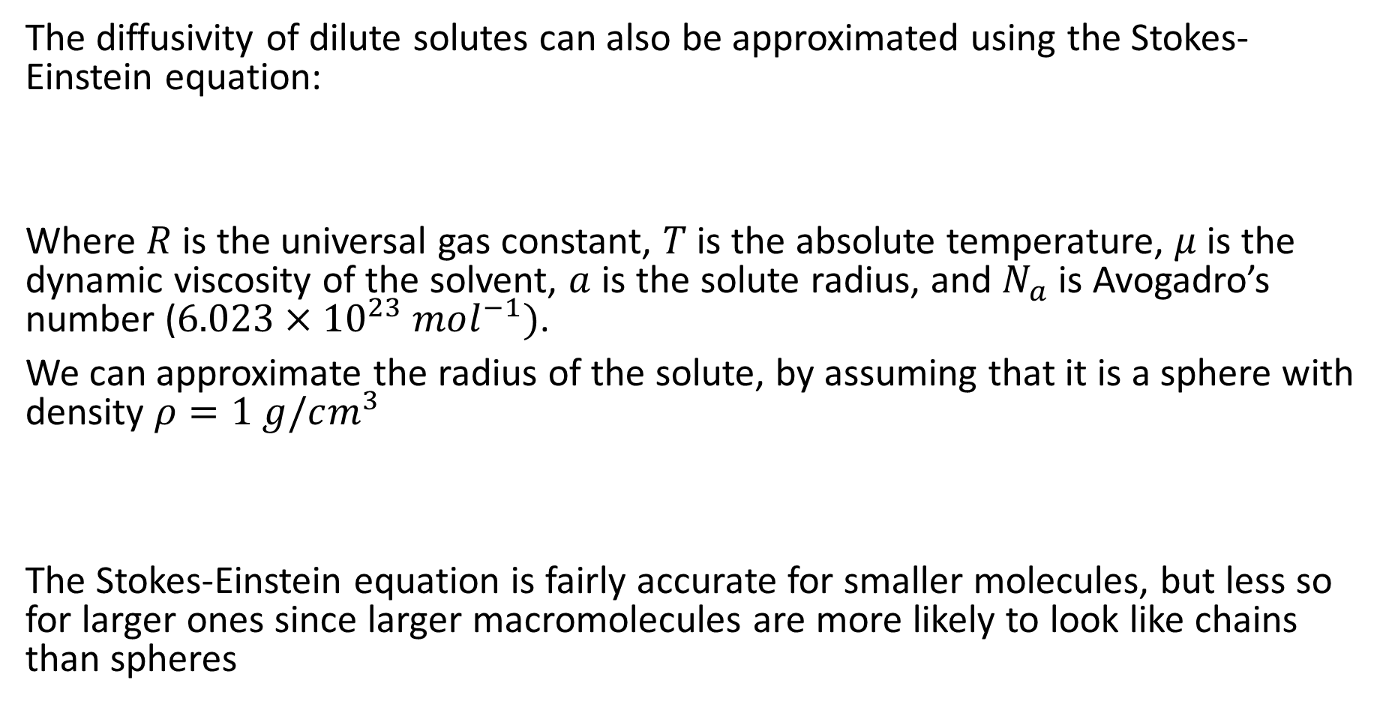
Diffusion Coefficient
The diffusivity of dilute solutes can also be approximated using the Stokes-Einstein equation:
Where $R$ is the universal gas constant, $T$ is the absolute temperature, $μ$ is the dynamic viscosity of the solvent, $a$ is the solute radius, and $N_{a}$ is Avogadro’s number ($6.023×{10}^{23} mol^{−1})$.
We can approximate the radius of the solute, by assuming that it is a sphere with density $ρ=1 g/cm^{3}$
The Stokes-Einstein equation is fairly accurate for smaller molecules, but less so for larger ones since larger macromolecules are more likely to look like chains than spheres

Slide 16
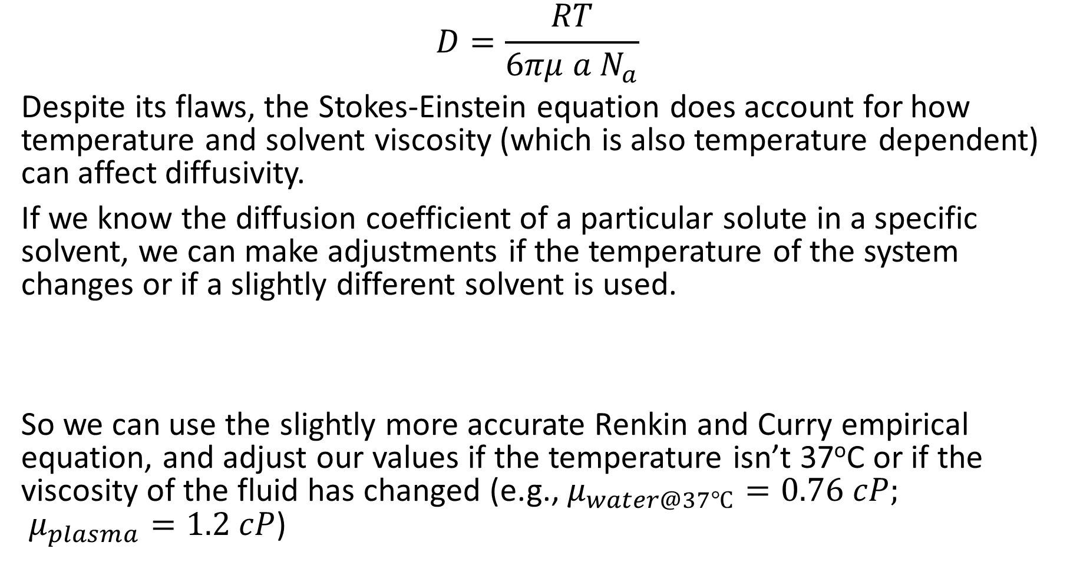
Diffusion Coefficient
$$D=\frac{RT}{6πμ a N_{a}}$$
Despite its flaws, the Stokes-Einstein equation does account for how temperature and solvent viscosity (which is also temperature dependent) can affect diffusivity.
If we know the diffusion coefficient of a particular solute in a specific solvent, we can make adjustments if the temperature of the system changes or if a slightly different solvent is used.
So we can use the slightly more accurate Renkin and Curry empirical equation, and adjust our values if the temperature isn’t 37ºC or if the viscosity of the fluid has changed (e.g., $μ_{water@37℃}=0.76 cP;$ $μ_{plasma}=1.2 cP$)

Slide 17






Steady-State Example
Consider the diffusion of a solute through two mediums as shown below. Develop an expression for the steady-state concentration profile in each material and an expression for the overall flux of solute through the composite material. Assume both materials have the same cross-section areas and lengths; they have different diffusivities. Assume the concentrations at each end are constant.
$$D_{1}$$
$$C_{0}$$
$$C_{L}$$
$$D_{2}$$
$$x$$
$$L$$

Slide 18
Steady-State Example
Start with Fick’s Second Law. The system is at steady state.
We will need two boundary conditions.
Integrate once:
And again:
Applying our boundary conditions we get:

Slide 19
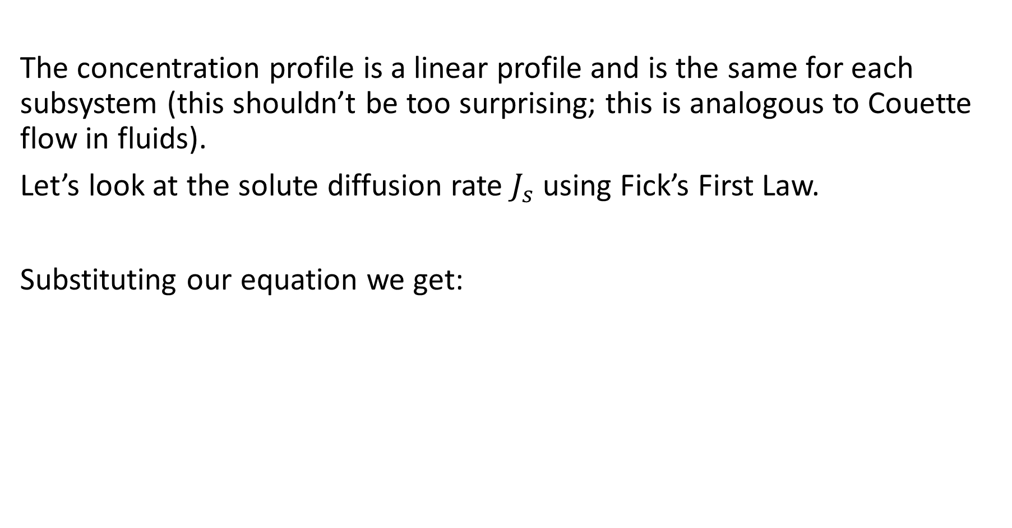
Steady-State Example
The concentration profile is a linear profile and is the same for each subsystem (this shouldn’t be too surprising; this is analogous to Couette flow in fluids).
Let’s look at the solute diffusion rate $J_{s}$ using Fick’s First Law.
Substituting our equation we get:

Slide 20
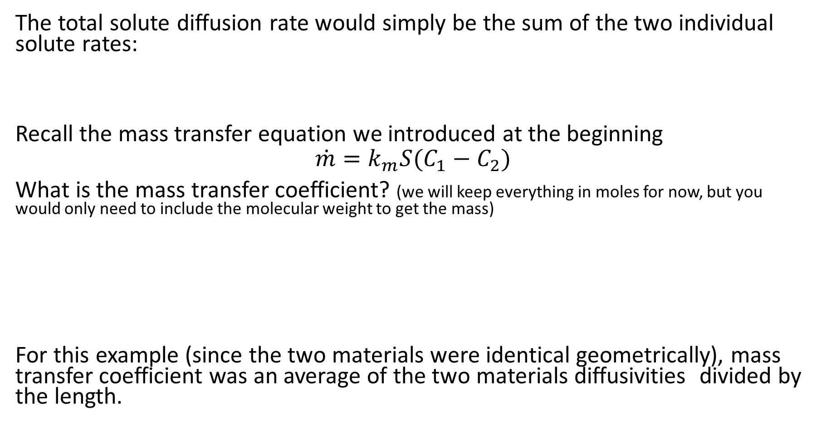
Steady-State Example
The total solute diffusion rate would simply be the sum of the two individual solute rates:
Recall the mass transfer equation we introduced at the beginning
$$\dot{m}=k_{m}S(C_{1}−C_{2})$$
What is the mass transfer coefficient? (we will keep everything in moles for now, but you would only need to include the molecular weight to get the mass)
For this example (since the two materials were identical geometrically), mass transfer coefficient was an average of the two materials diffusivities divided by the length.

Slide 21

Effective Diffusivity
Fick’s First Law is written as:
$$J_{s}=−DS\frac{dC}{dx}$$
We can determine an effective diffusivity for the overall system
The effective diffusivity is (for this example):

Slide 22
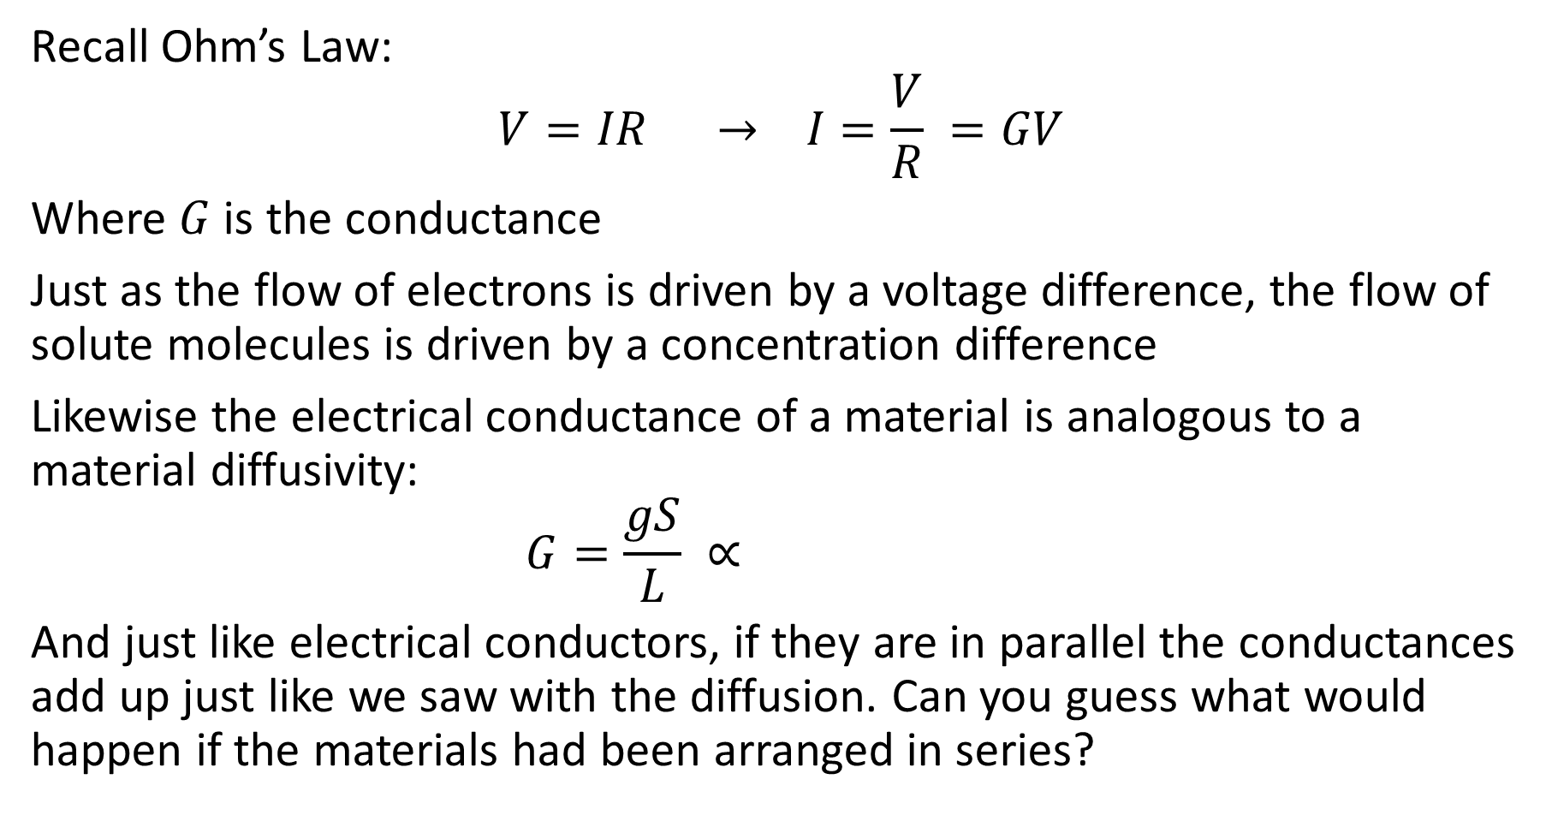
Mass Transfer and Circuits
Recall Ohm’s Law:
$$V=IR → I=\frac{V}{R} =GV$$
Where $G$ is the conductance
Just as the flow of electrons is driven by a voltage difference, the flow of solute molecules is driven by a concentration difference
Likewise the electrical conductance of a material is analogous to a material diffusivity:
$$G=\frac{gS}{L} ∝$$
And just like electrical conductors, if they are in parallel the conductances add up just like we saw with the diffusion. Can you guess what would happen if the materials had been arranged in series?

